Slide 1
AP Automation Breakout
Olav Maas & Kevin Kamau

Slide 2

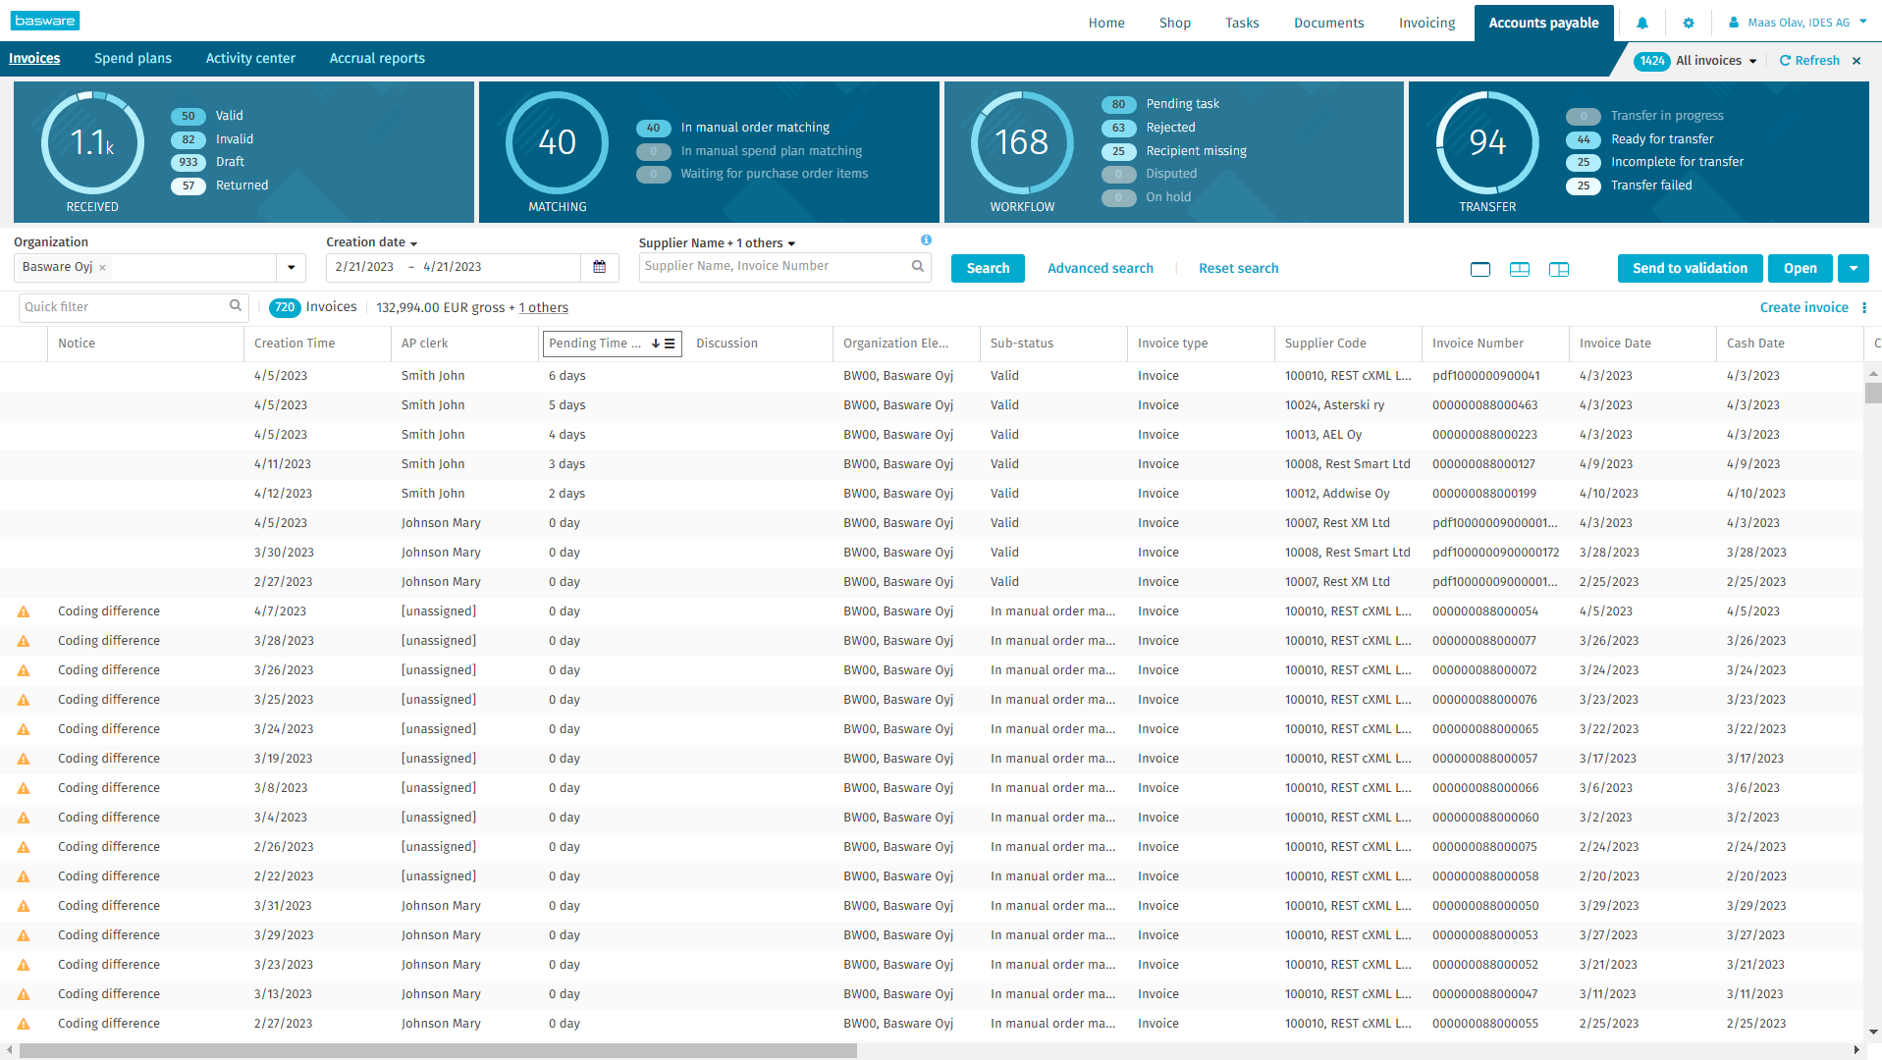
AP Workload Management
Distribute workload flexibly and prioritize the right documents to meet SLAs
Flexible distribution of invoice workload among the AP teams to get dedicated backlog queues
Real-time info to AP managers on how the backlog is progressing and if action is needed for redistribution
Pending time provides real-time insights to the AP clerks on which invoice documents should be prioritized to meet KPIs
Notes:
Real time insights – steer your teams and organize work
Tool set:
Automatic workload distribution
Invoice aging inisghts for prioritization by AP
Batch actions for deviations (normal AP stuff, not new)
Outcome:
Efficient processed documents and ontime payments
Optmized backlogs
Context: What is the impact on customer value/business objectives.
What metrics does it improve (Efficiency, compliancy for example)
What is it:
Instead of X, now you can ...
Who benefits from this
What is new with it
How does it work:
Functionality, what does it do

Slide 3
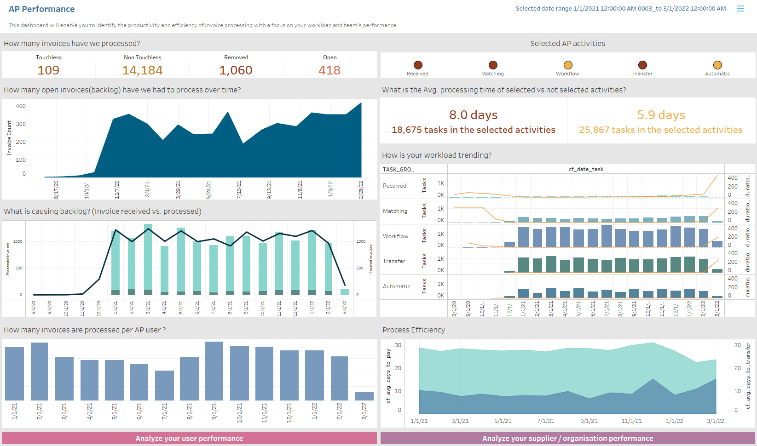
AP Team Performance
Analyze and optimize the efficiency of your team performance with the new Basware Insights dashboard
Monitor team's performance and productivity & continuously improve and optimize the efficiency of your AP team by finding factors that affect the efficient processing of invoices
Provides answers to the following primary questions:
What is my team's workload and output?
What has my AP team done?
How long does it take to process invoices and where do the bottlenecks lie?

Slide 4
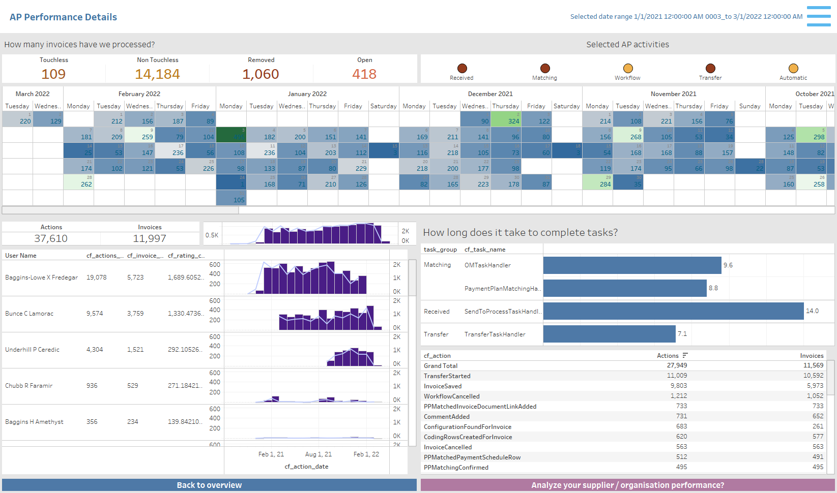
AP Team Performance
Dive deeper into each team's and AP clerk's workload
Answers the following questions
Who has done what?
How long does it take to process invoices and where do are the bottlenecks?
What has been done?

Slide 5
Thank you

