Slide 1
Basware Bespoke 27 April
Procurement breakout session

Slide 2



Hosts
Urmil Mehta
Taija Björklund
Sanna Eklund
Vice President
Product Development
Product Manager
Procurement
Manager
Product Marketing

Slide 3
Integrated shopping experience

Slide 4
Improved user experience
Seamless buying
Better control
Increased adoption
Users have one place to start their purchasing journey
Reducing number of clicks and bouncing between areas
Gives organizations ability to better control visibility
Closer to the familiar webshop experience
More savings and spend visibility when user are more likely to use Purchase

Slide 5
ONE-STOP SHOP EXPERIENCE
More shopping enhancements and innovations coming
UNIVERSAL PRODUCT SEARCH
Uniting search capabilities and benefits from both platforms
SINGLE
BASKET
Simplified checkout experience
Notes:
There should be no learning required to start shopping. This is what we are trying to achieve: there is universal search and a single basket.
Integration of Purchase and Marketplace lays the foundation for future shopping experience enhancements and innovations
Recommending customers to migrate to Integrated shopping experience
Old shopping experience will be deprecated in the future!
Get advantage of the newest features, we recommend moving to Integrated shopping experience. Note also that if you would be interested in taking Amazon Business into use I the future, Integrated shopping experience will be a pre-requisite for that.
More shopping enhancements and innovations coming
Uniting search capabilities and benefits from both platforms
Marketplace catalog and punchout items
Purchase free-text-forms
Simplified checkout experience
Complete purchase for all items in one place
Option to 'express' checkout for single item purchases

Slide 6
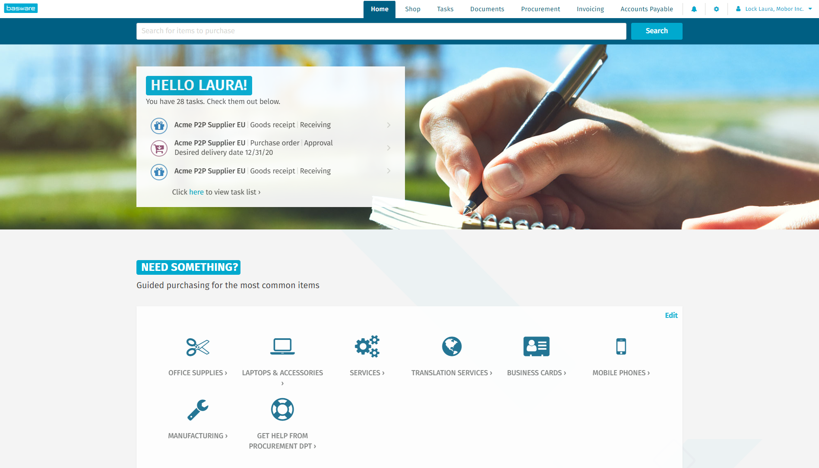
Demo
Notes:
”Some of you may have seen demos of Integrated shopping experience already or you may have enabled ISE in your test environment, but we wanted to take this opportunity to hear your feedback and questions about the Integrated shipping experience and also to let y show that we are constantly improving the experience based on customer feedback. So you can use the opportunity to give feedback on the features I’m showing to you or ask if there is anything you are wondering about. Feel free to comment or ask questions during the demo”

Slide 7
New features

Slide 8
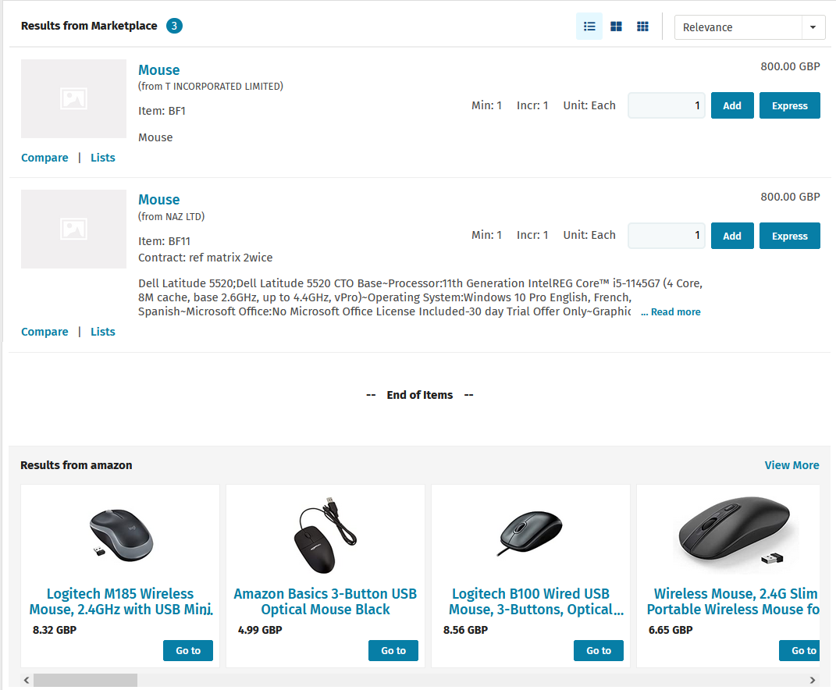
Amazon federated search
Notes:
Integrated shopping experience enables taking Amazon catalogues and federated search into use.
With federated search company employees can search across Amazon catalogs and compare the Amazon business- and supplier site items on a single screen. Gives true consumer style shopping experience.
Federated search can also be used for other catalog providers than Amazon

Slide 9
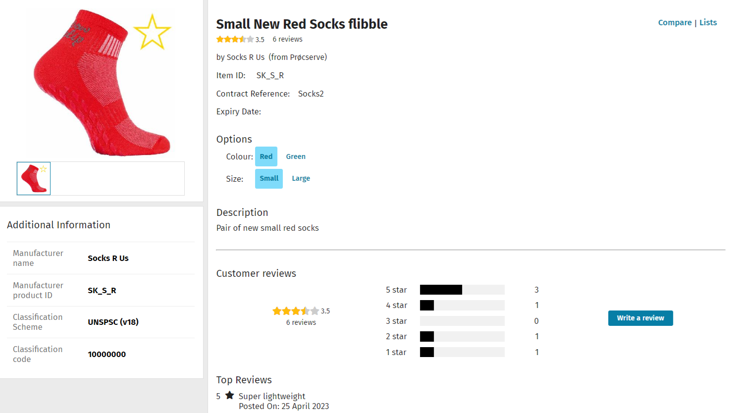
Ratings and reviews
Notes:
Similar to consumer-style shopping, it will be possible for buyers can rate and review catalog items
Q2

Slide 10
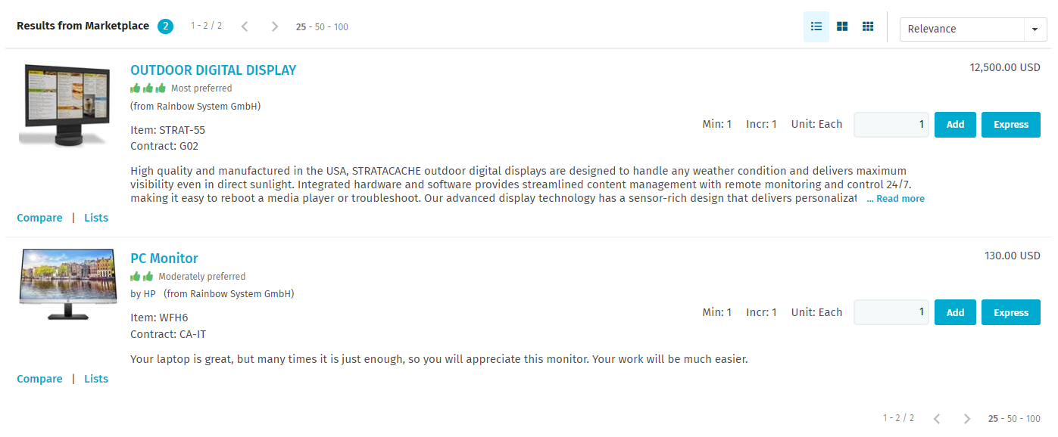
Weighted preferred items
Notes:
Quote often you have multiple similar items either from the same supplier or you have them from different supplier, but you would still like the requesters to know which item they should buy.
For this purpose, you can mark entire agreements or individual items as preferred.
Now the preferred items has been enhanced with grading or weighting, you can have “Most preferred items”, “Moderately preferred items” or “Slightly preferred items”.
The weighted preference can be set in both Product Manager and in the Super Content Loader.

Slide 11
Procurement roadmap

Slide 12
Procurement roadmap
Available:
Now
Q2’ 23
Q3-Q4 ’ 23
Exploring
<
Basware Shopping: Amazon punchout and Amazon catalog search
Access to a wide range of items from Amazon directly from Marketplace search.
Agility to procurement process
Purchase order row-level approval available
Purchase requisitions can be approved directly via email
Possibility to select budget amount type
Buyers can rate and review catalog items
Quick quote for suppliers -new process and interface
Agility to procurement process
New criteria for approval retriggering and other workflow enhancements
cXML ordering
Buyer-managed bundles can contain items from different suppliers
Allowing multiple line field updates
Procurement policy digitization
PROCUREMENT
Follow-up, increase compliance, make your policies easy to use and report on
Supplier sustainability
Quick source for buyers
Versatile Purchase Order approval workflows to suit all customer needs
New process and interface
Tools for power users in Basware Purchase

Slide 13
Thank you
Urmil Mehta, urmil.mehta@basware.com
Taija Björklund, taija.bjorklund@basware.com
Notes:
Thank you for participating in this session. We would love to hear feedback from you, please reach out to us, if you have any questions or comments

